Slide 1
CSE 4539 (CSE) / CSE 4581 (BScTE (2yr) 1st Sem)
: Web Programming
Introduction to Web Programming
Md. Nazmul Haque
Lecturer, IUT
Department of Computer Science and Engineering
Islamic University of Technology
August 2, 2022
Notes:
Assalamualaikum, good day my respected teachers, audiences. Today I am going to present my thesis paper titled “Class Specific feature Selection for High Dimensional low sample size Data”. I am Nazmul haque and my supervisor is Dr. Mohammad Shoyaib.
Before going in detail about my Literature review, I would like to give an outline of my whole presentation.

Slide 2
Contents
Contents
Motivation
Objective
Course outline

Slide 3
Motivation
Web developer
https://www.zippia.com/web-developer-jobs/demographics/
https://www.geeksforgeeks.org/8-tips-to-stay-motivated-as-a-web-developer/

Slide 4
Objective
Objective
How the internet works
Relationship between clients and servers
How web pages are built using
HTML: author the web page
CSS: style the web page
JS and AJAX: create an interactive web pages
PHP: Handle and respond to web service requests
SQL: interact with the database

Slide 5
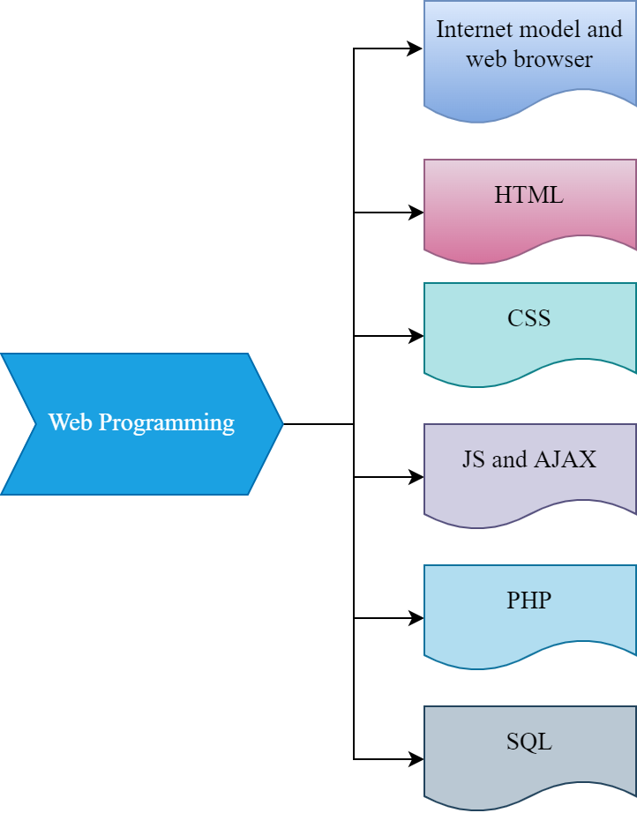
Course Outline
Course outline

Slide 6
Recommended Texts:
Recommended Texts
Recommended Texts:
Jennifer Niederst Robbins and Aaron Gustafson, Learning Web Design: A Beginner's Guide to (X)HTML, StyleSheets, and Web Graphics, O'Reilly Media, 3rd Edition, 2007.
Luke Welling and Laura Thomson, PHP and MySQL Web Development, Addison-Wesley Professional, 5th Edition, 2016.
Shelley Powers, Learning JavaScript. O'Reilly Media, 2nd Edition, 2008.
Matt Gibbs and Dan Wahlin, Professional ASP.NET 2.0 AJAX, Wrox, 1st Edition, 2007.
Bogdan Brinzarea and Cristian Darie, AJAX and PHP: Building Modern Web Applications, Packt Publishing, 2nd Edition, 2010.

Slide 7
ANY QUESTION ?
THANK YOU !

Slide 8
References
References
[1] W3school.com

